Slide 1
Chapter 3
  Data Exploration

Slide 2
Data Exploration
Data exploration can be broadly classified into two types—
    descriptive statistics.
    data visualization

Slide 3
DESCRIPTIVE STATISTICS
  Descriptive statistics refers to the study of the aggregate quantities of a dataset. Descriptive statistics can be broadly classified into
  Univariate Exploration
  Multivariate Exploration

Slide 4
Multivariate Exploration
  Multivariate exploration is the study of more than one attribute in the dataset simultaneously. This technique is critical to understanding the relationship between the attributes, which is central to data science methods.
  Correlation: Correlation measures the statistical relationship between two attributes, particularly dependence of one attribute on another attribute. When two attributes are highly correlated with each other, they both vary at the same rate with each other either in the same or in opposite directions.
  For example, consider average temperature of the day and ice cream sales. Statistically, the two attributes that are correlated are dependent on each other and one may be used to predict the other. If there are sufficient data, future sales of ice cream can be predicted if the temperature forecast is known.

Slide 5
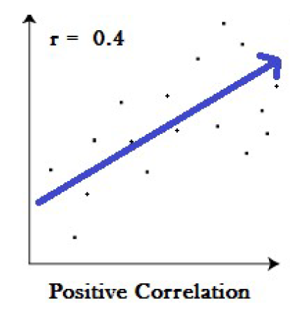
Multivariate Exploration
  Types of correlation:
  Positive correlation: A positive correlation is a relationship between two variables in which both variables move in the same direction. Therefore, when one variable increases as the other variable increases, or one variable decreases while the other decreases.

Slide 6
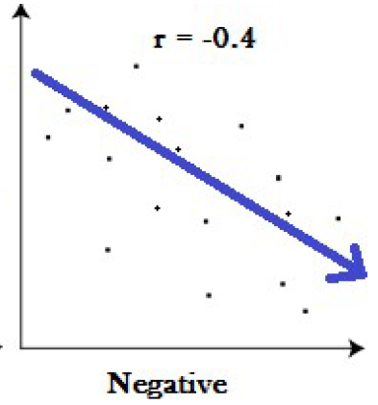
Multivariate Exploration
  Negative correlation: A negative correlation is a relationship between two variables in which an increase in one variable is associated with a decrease in the other. Example: Price and demand of a commodity.

Slide 7
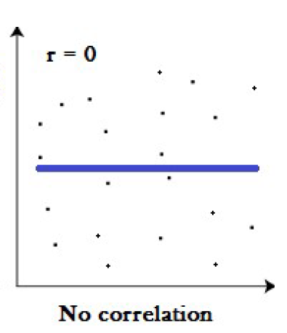
Multivariate Exploration
  Zero correlation: A zero correlation exists when there is no relationship between two variables. For example there is no relationship between the amount of tea drunk and level of intelligence.

Slide 8
Multivariate Exploration
Correlation between two attributes is commonly measured by the Pearson correlation coefficient.
Correlation coefficients take a value from
Value closer to 1 or -1 indicates the two attributes are highly correlated, with perfect correlation at 1 or -1.
A correlation value of 0 means there is no linear relationship between two attributes.

Slide 9
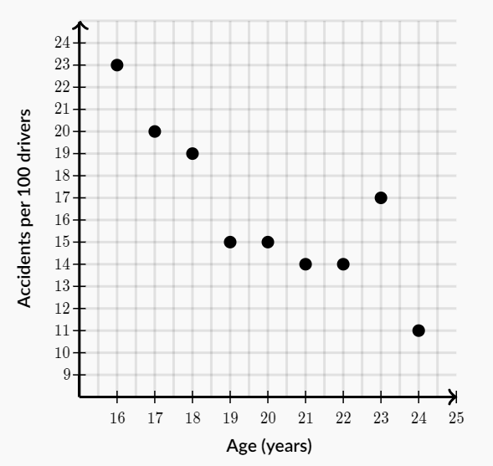
Correlation Example:
The graph shown below shows the relationship between the age of drivers and the number of car accidents per 100 drivers in the year 2009.
What is the best description of this relationship?

Slide 10
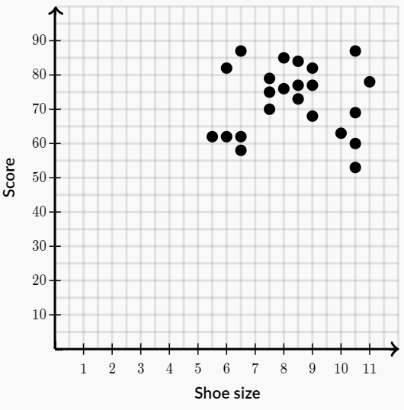
Correlation Example:
The graph below shows the relationship between test grades and shoe sizes of the students in University class.
What is the best description of this relationship?

Slide 11
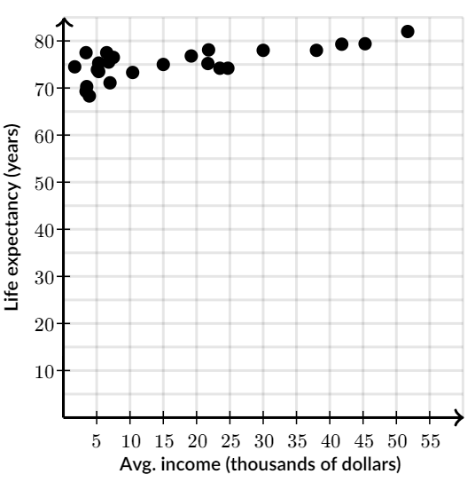
Correlation Example:
The graph below shows the relationship between life expectancy and income in a random sample of countries.
What is the best description of this relationship?

Slide 12
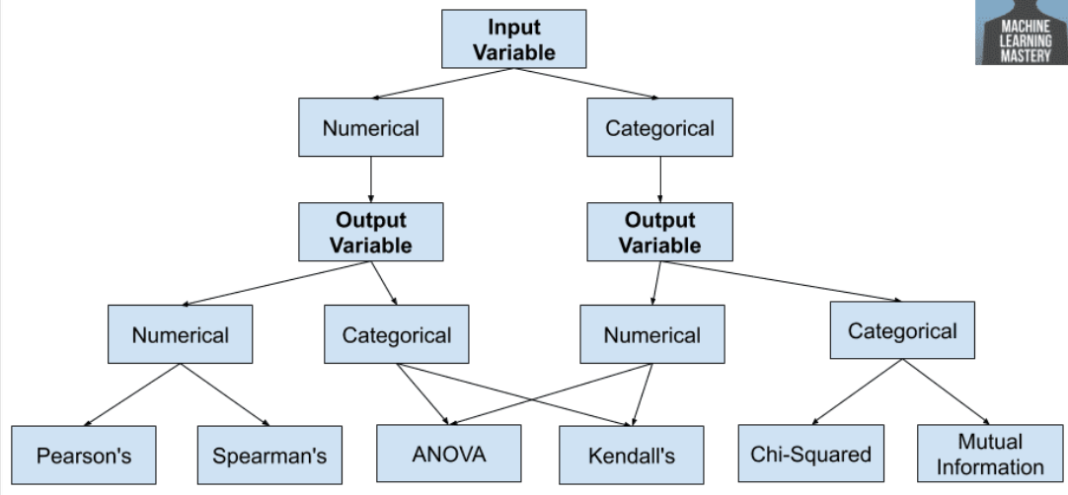
How to choose a Feature Selection Method For Machine Learning

Slide 13
Multivariate Exploration
Remember: Correlation does not mean causation. The phrase “correlation does not imply causation” is often used in statistics to point out that correlation between two variables does not necessarily mean that one variable causes the other to occur.
Example 1: Ice Cream Sales & Shark Attacks ?.
Example 2: High School Graduates vs. Pizza Consumption ?
Example 3: Master’s Degrees vs. Box Office Revenue ?

